Slide 1
Half Yearly Work Review
Name:-Abhilash Pathak
Designation:-Faculty
Literacy india bijwasan

Slide 2
Agenda
Survey and mobilization
Students information
Attendance
Classroom images
Academic Performance
Extracurricular Activity
Achievements
Conclusion
Suggestion

Slide 3
Important Note
In this presentation, I'm excited to share my transformative journey over the past six months, during which I had the unique opportunity to work at both the Chhawla and Bijwasan Old Centers

Slide 4
Purpose
My purpose today is to share my transformative six-month journey with Literacy India, where every moment was dedicated to bringing positive change and making a difference.

Slide 5
Student Information of chhawla Community Center
Total No. of Students | 128
Number of Male | 66
Number of Female | 62
Number of students in CCA | 84
Number of students in Code.org | 23
Number of students in Full Stack | 21

Slide 6
Student Information of Bijwasan OLD Community Center
Number of students | 123
Number of Girls | 91
Number of boys | 32
Number of students in CCA | 123

Slide 7
Student Attendance in chhawla center

Slide 8
Student Attendance in Bijwasan Old center

Slide 9
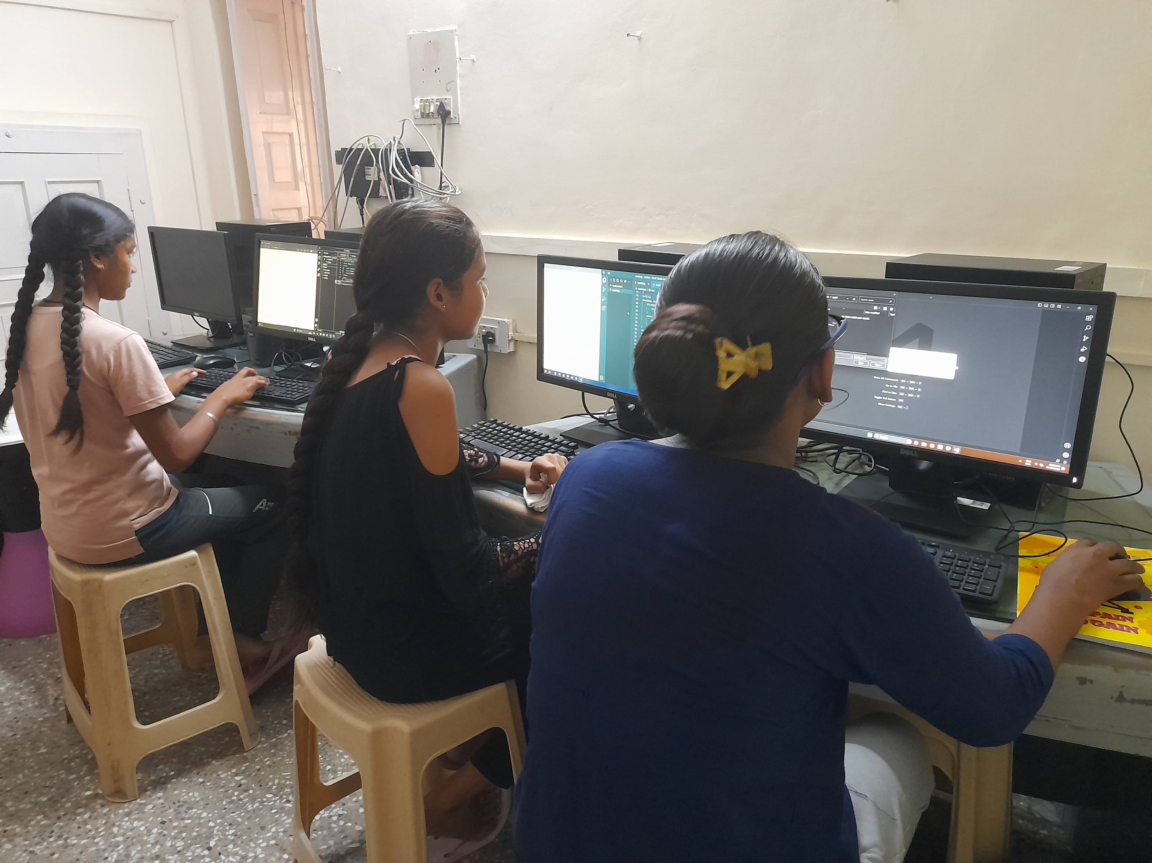
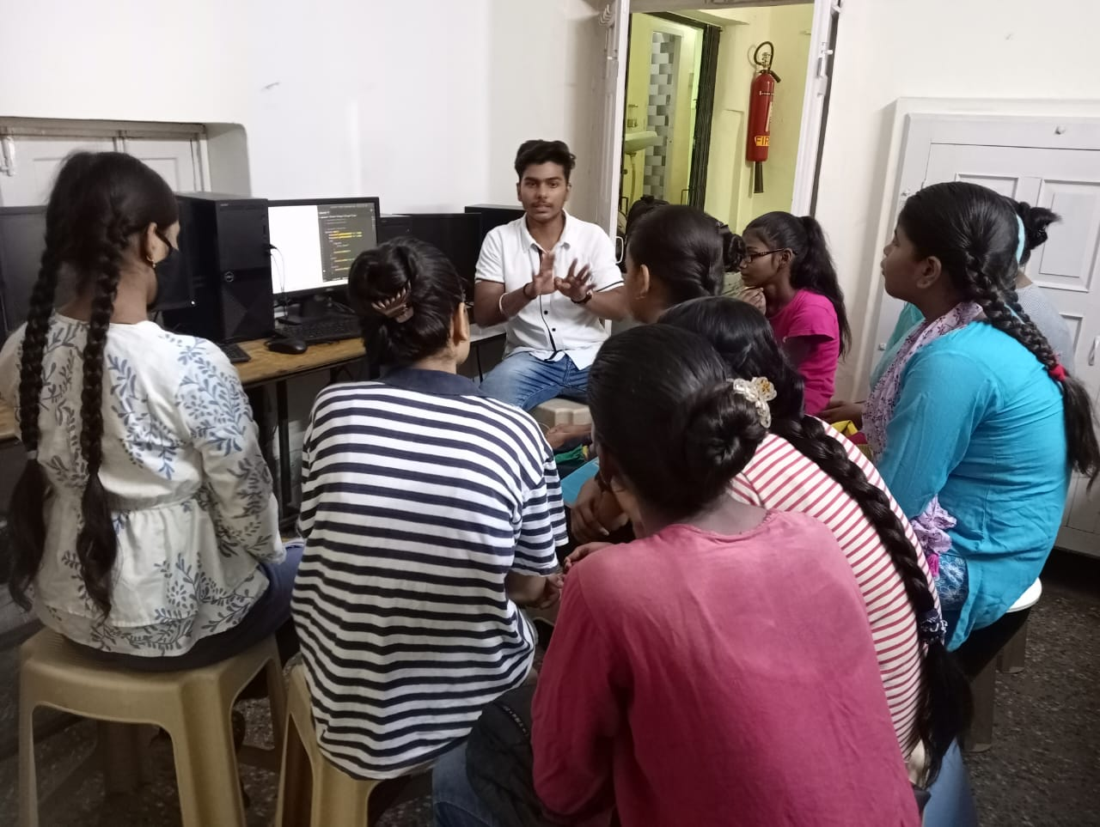
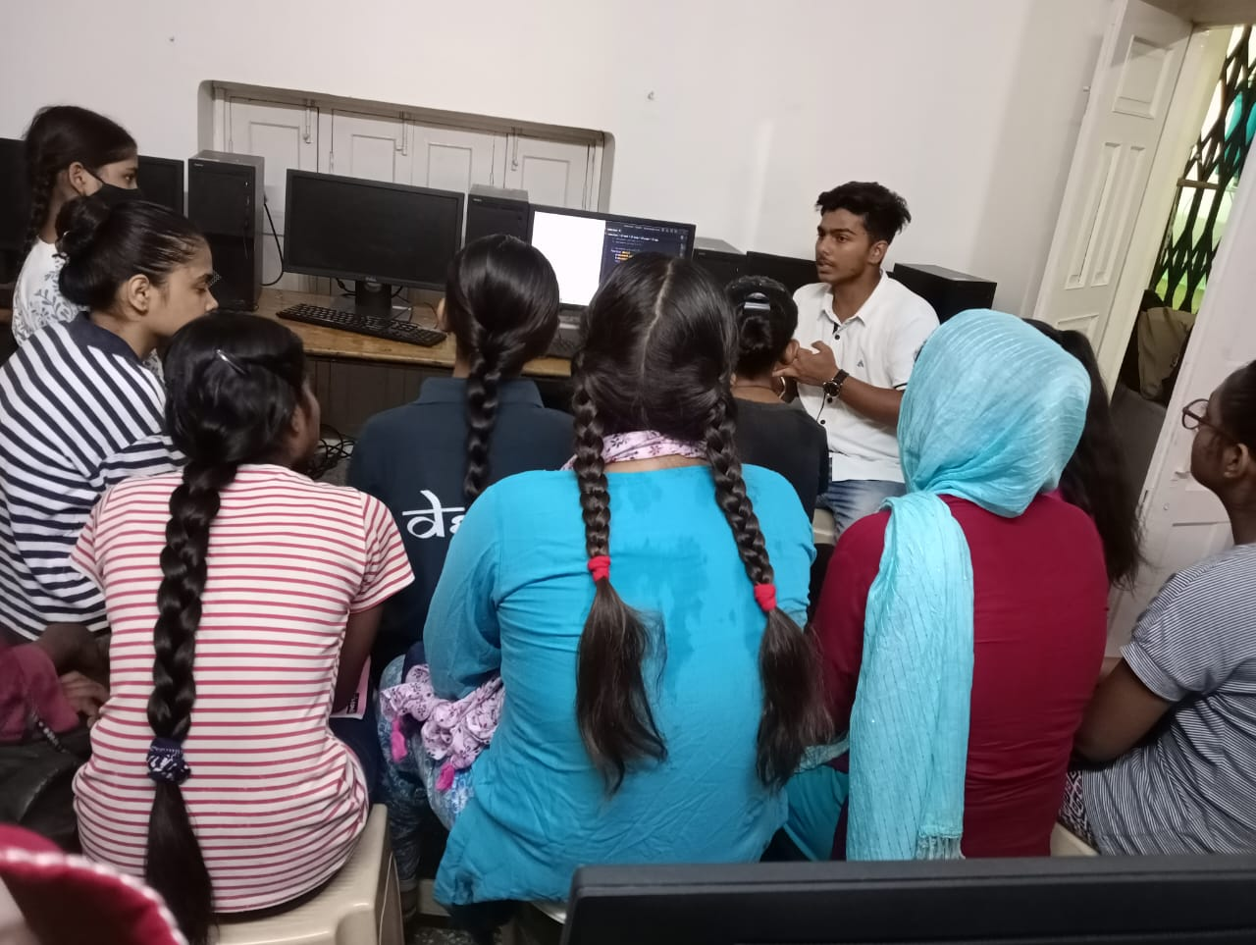
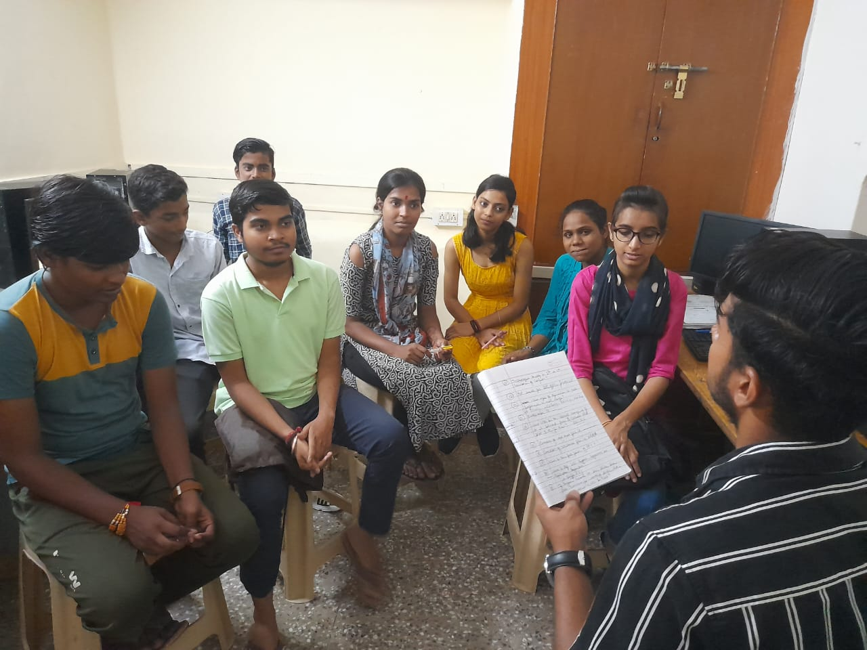
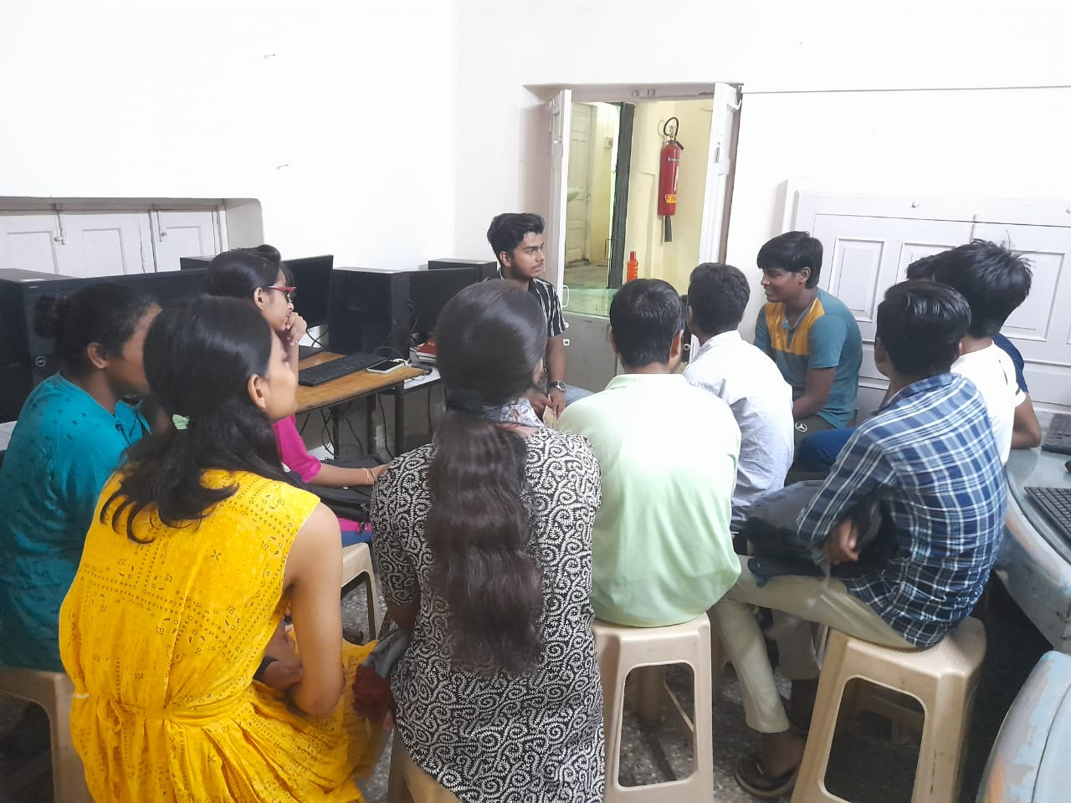
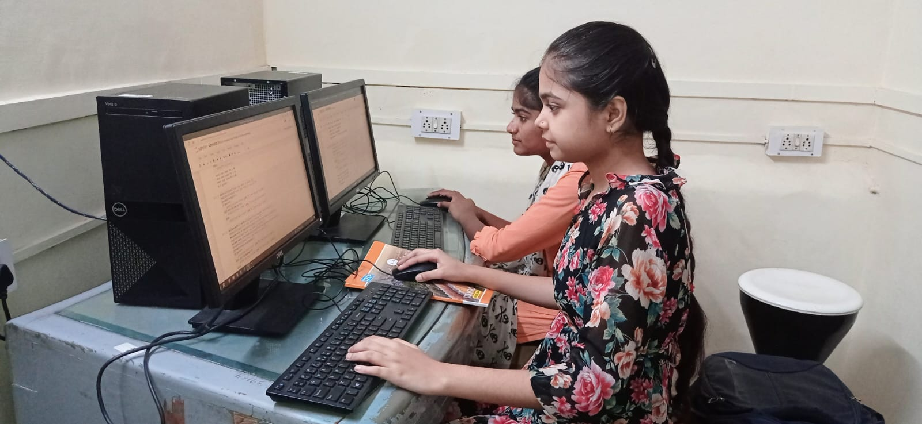
Classroom Images

Slide 10
Academic Performance
Curriculum overview
Networking
M.S Office
HTML
CSS
Core python
Javascript
Canva
Email

Slide 11
In last six month we are celebrating World Environment Day Activity, Mother’s Day Activity, Debate on Chandrayan-3 Delhi Flood, Independence Day Activity, Teacher’s Day Activity, Janmashtami Activity, Google Doodle Activity, Coding Hackathon, AI Activity, Career Counseling Session, Robotics Session by Mr. Prashant Sir and Mr. Govind Sir, Time Management Session by Bhanu Priya Mam, Improve Teaching Skill Session by Seema Prabhakar Mam, Curriculum Training by Vineet Sir, Here is some images attached.

Slide 12
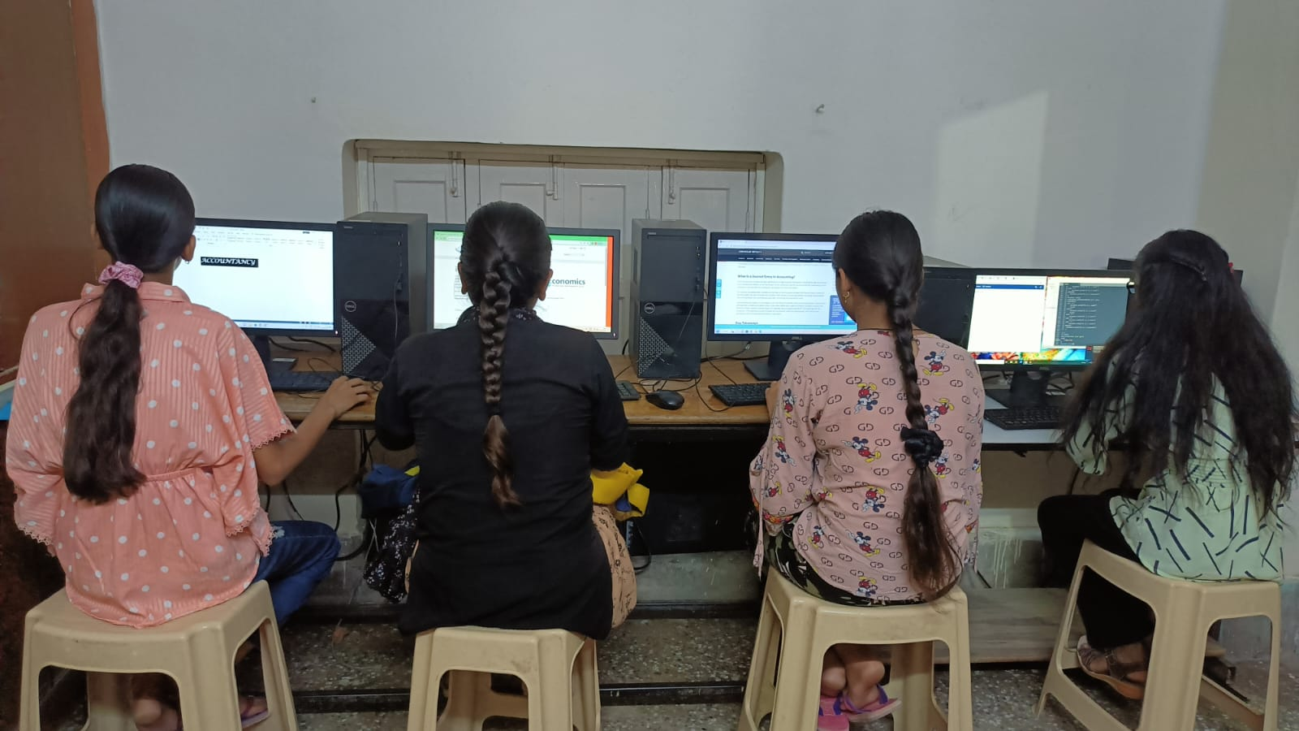
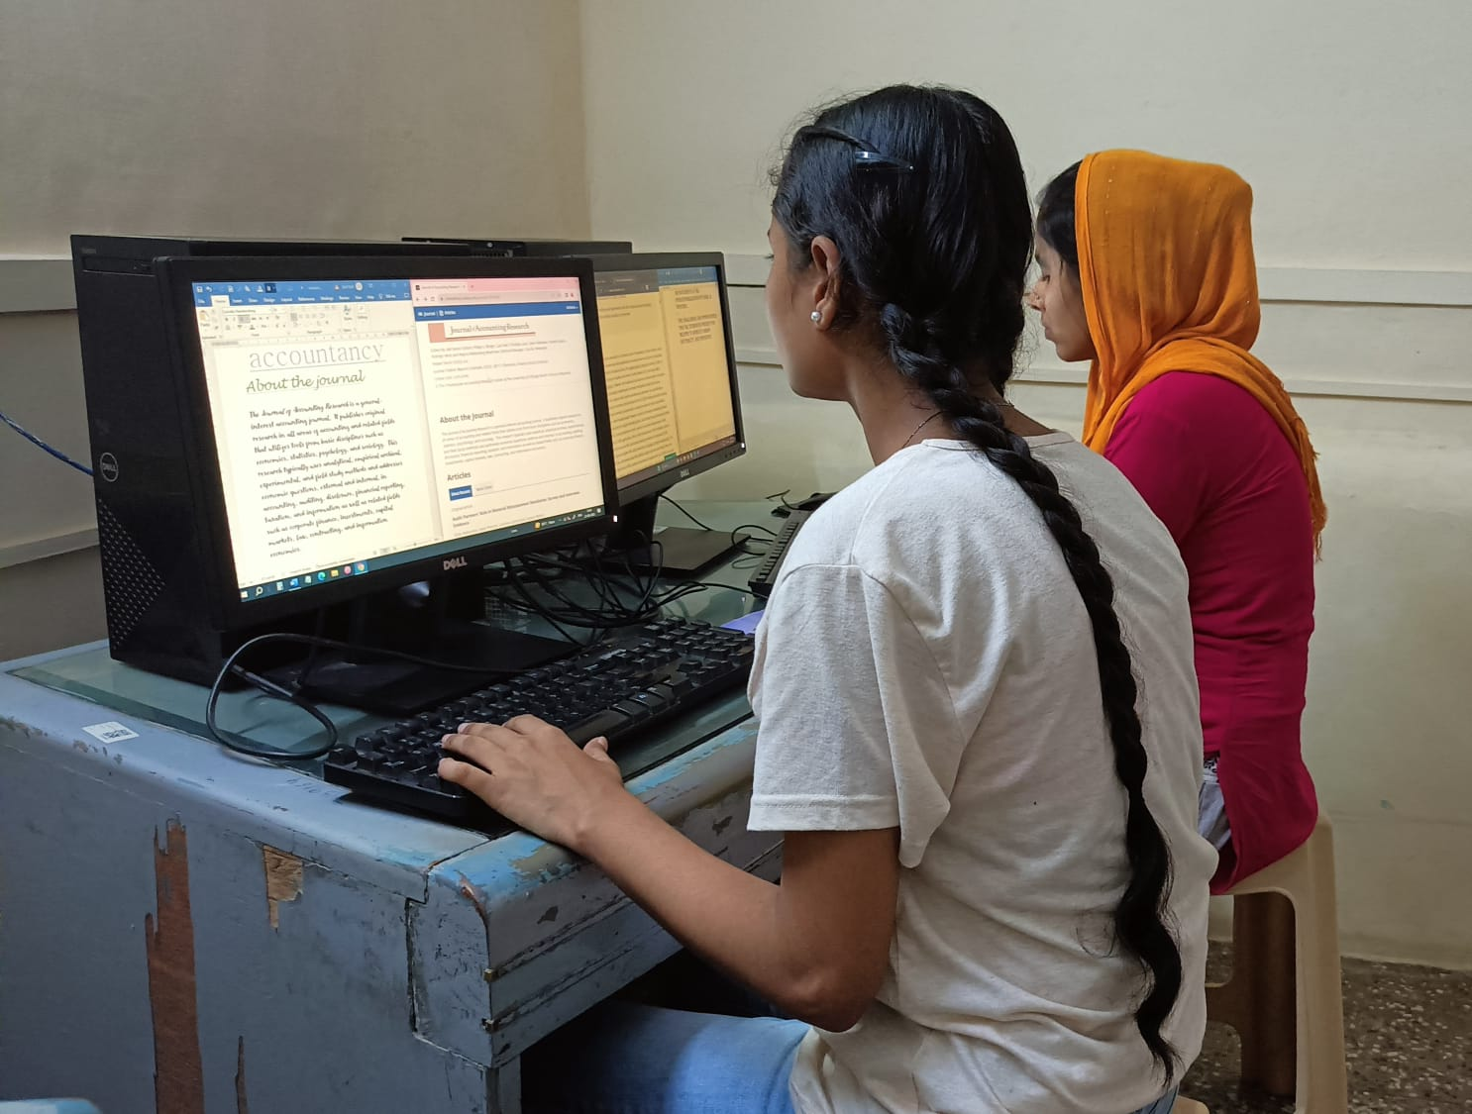
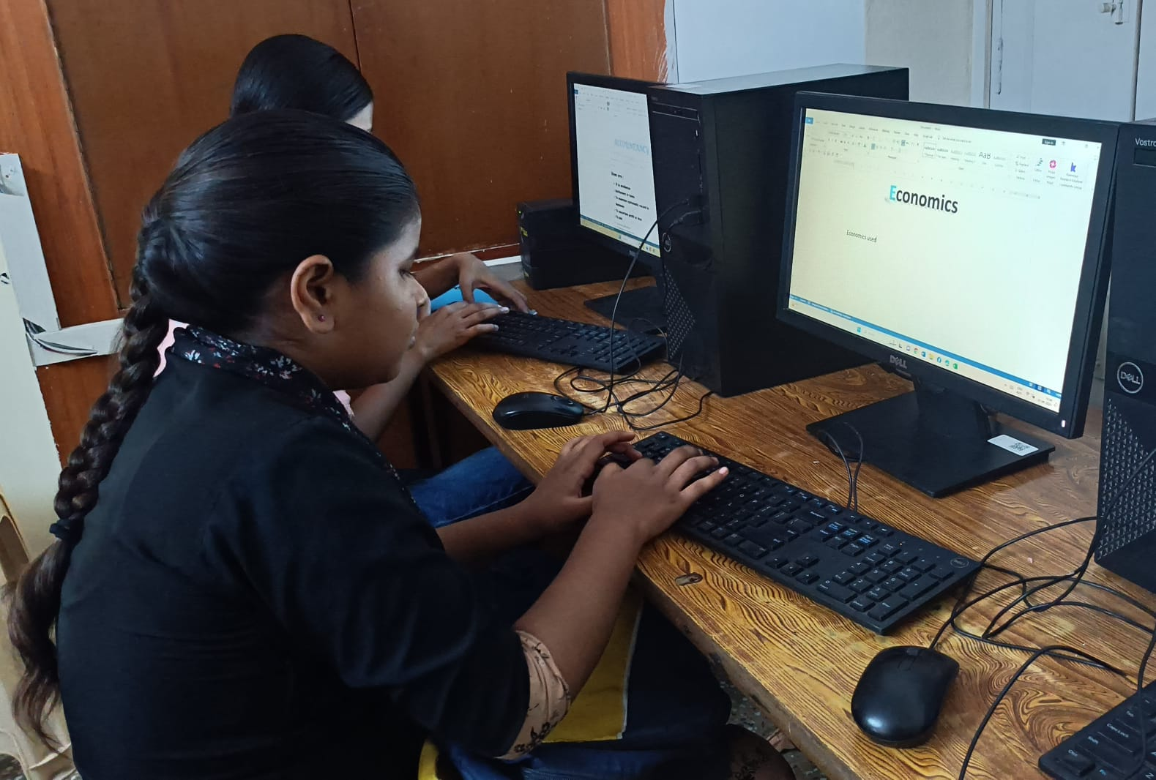
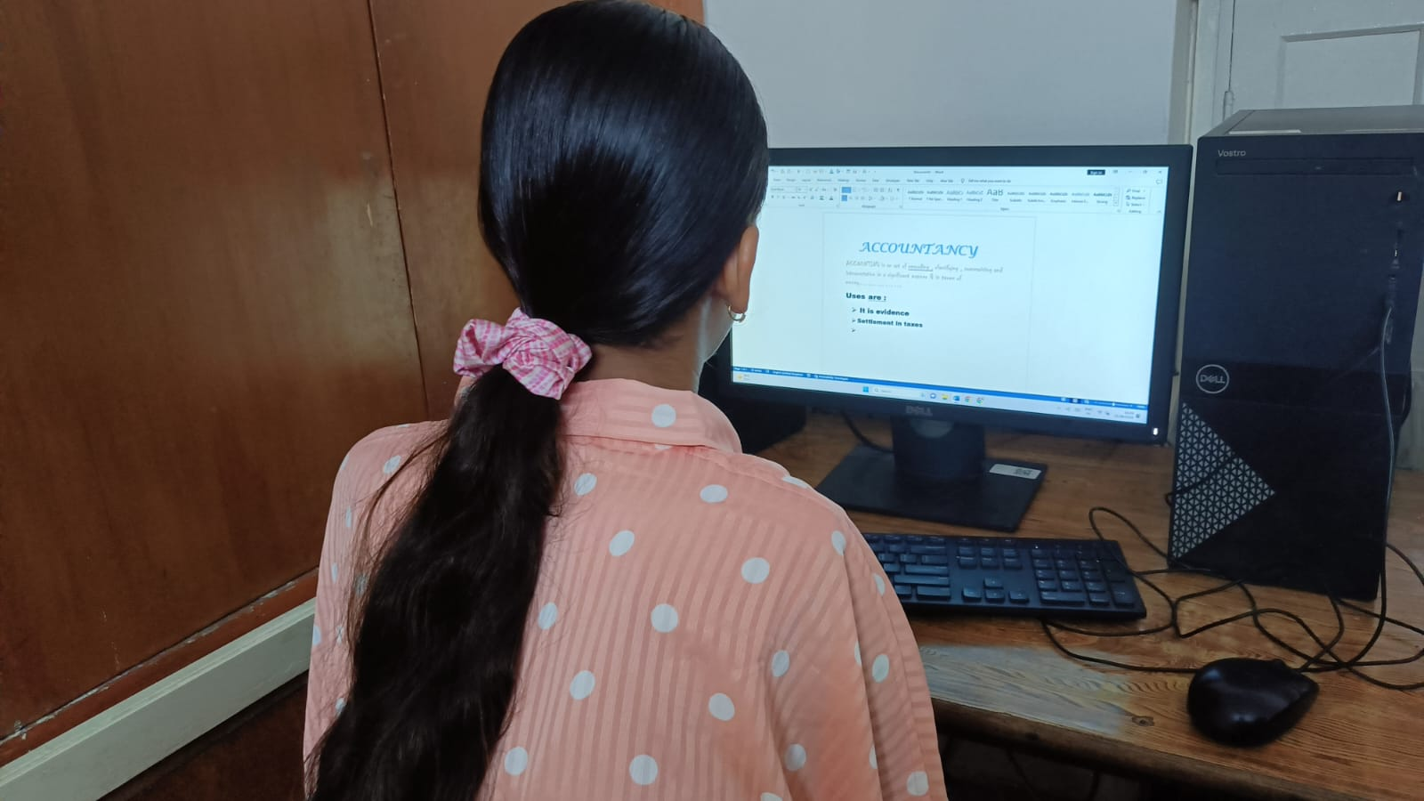
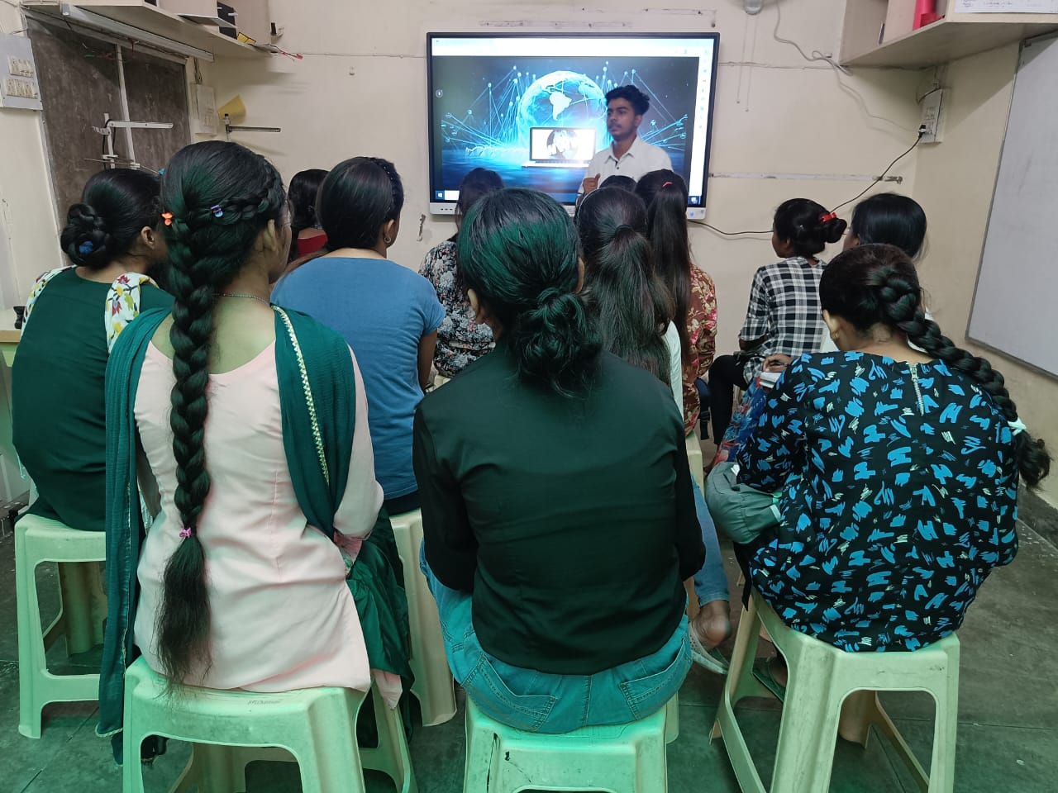
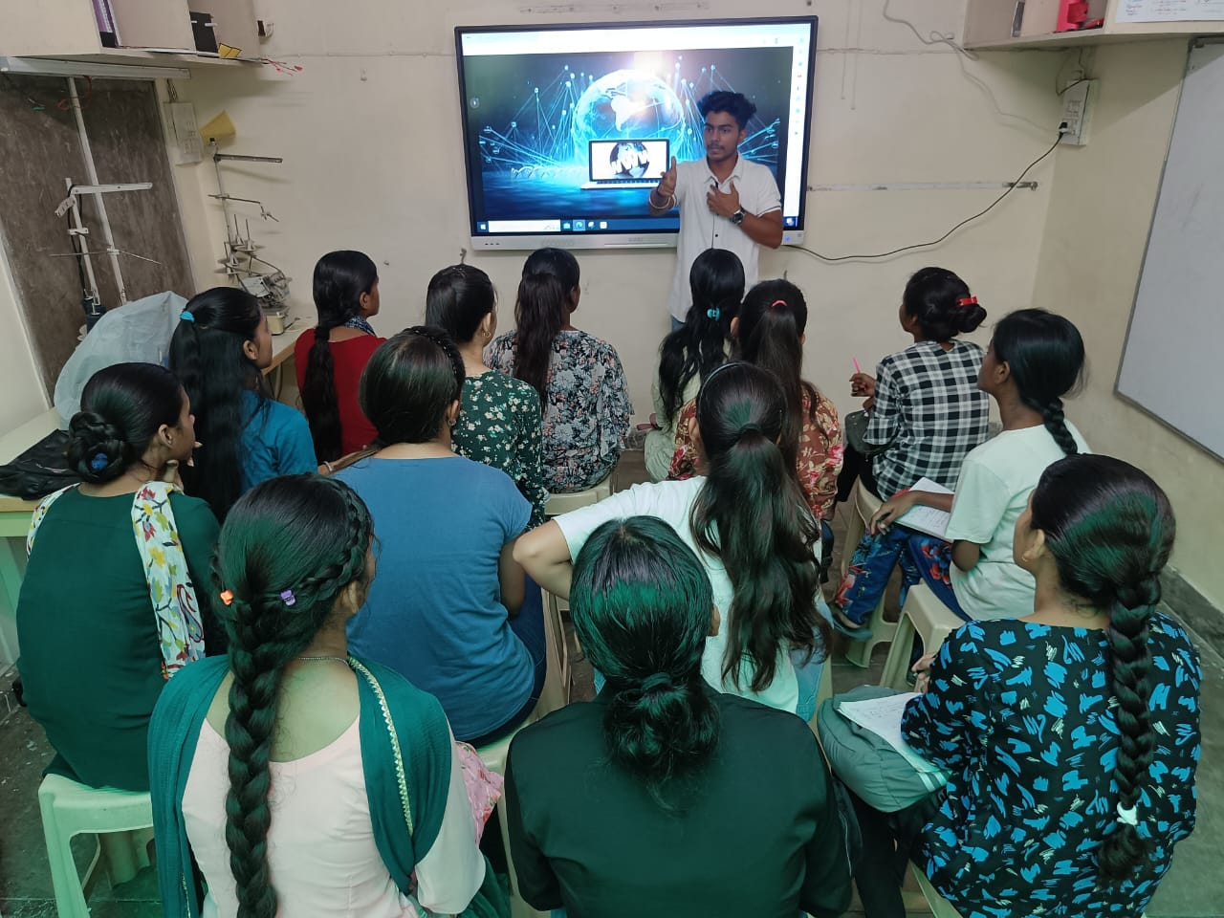
Extracurricular Activities images

Slide 13
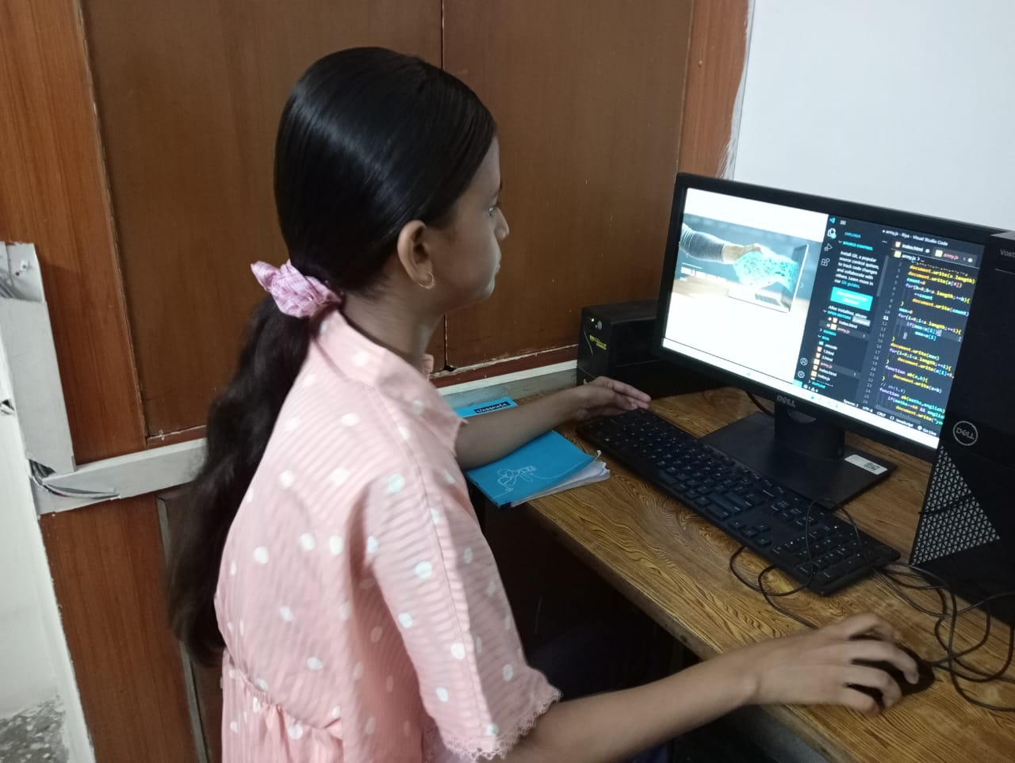
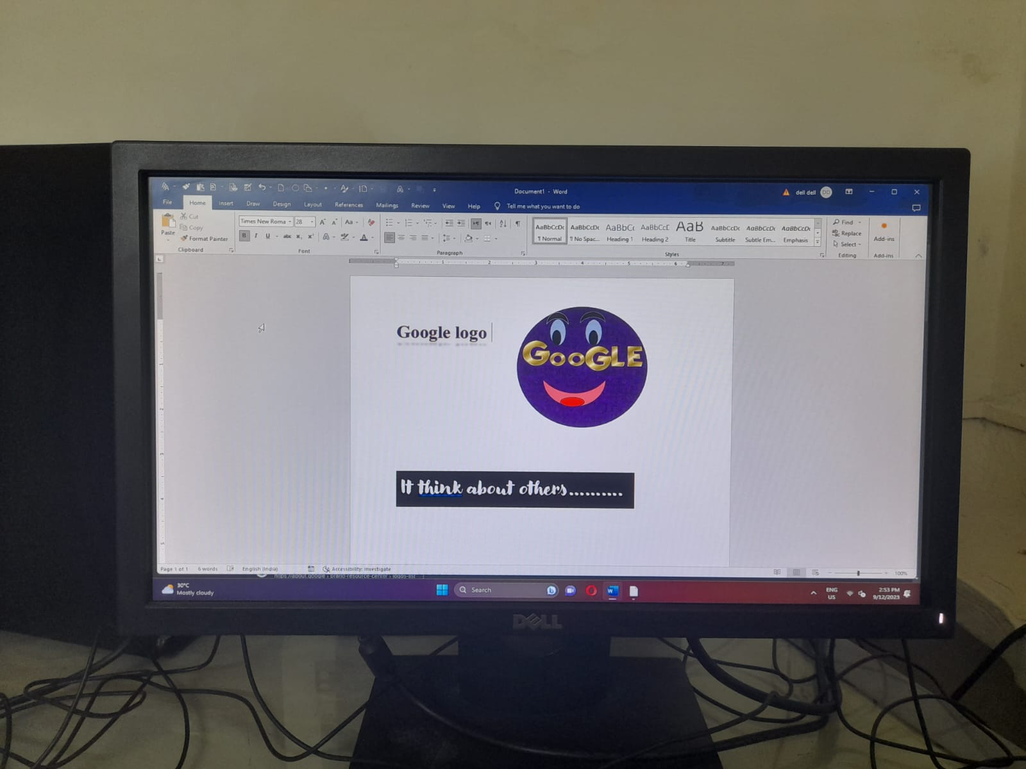
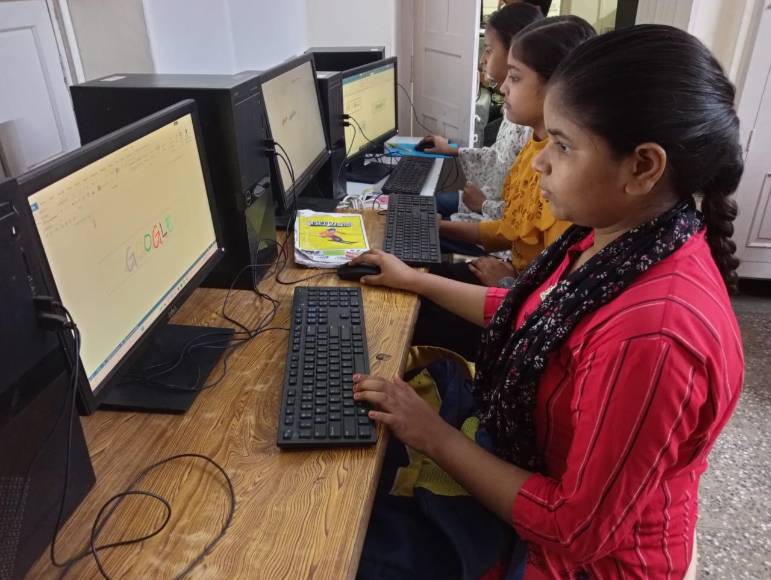
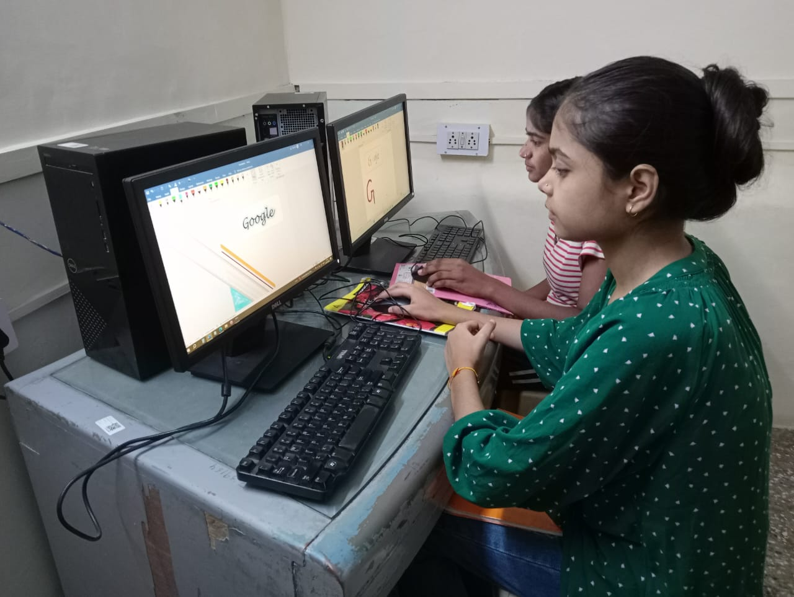
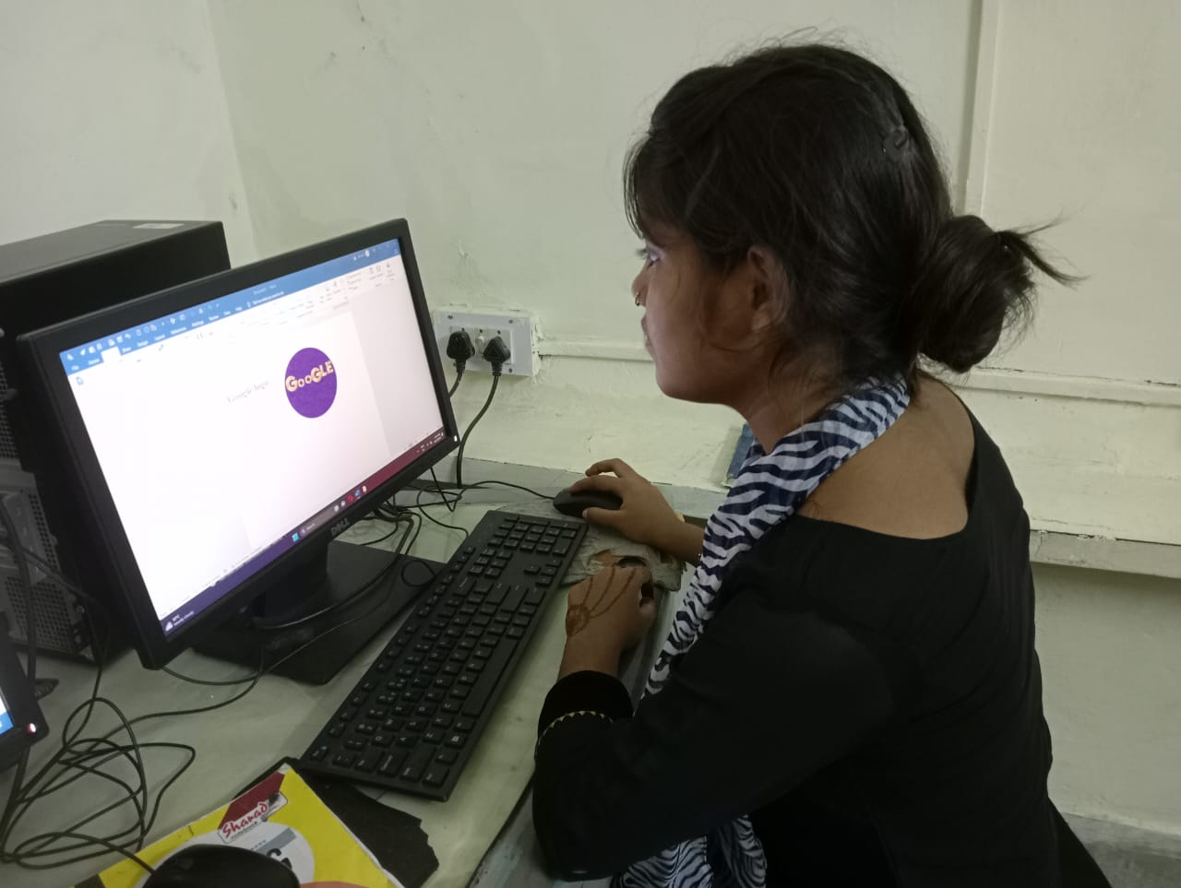
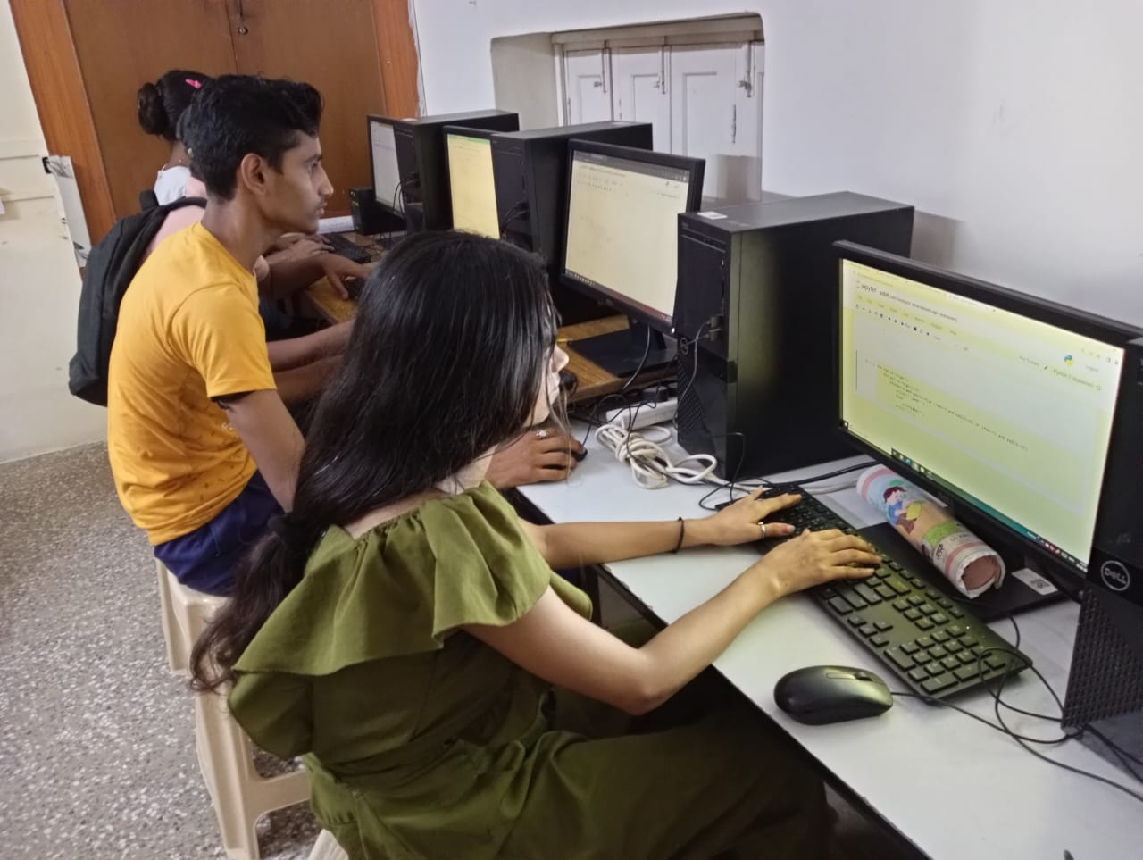

Slide 14
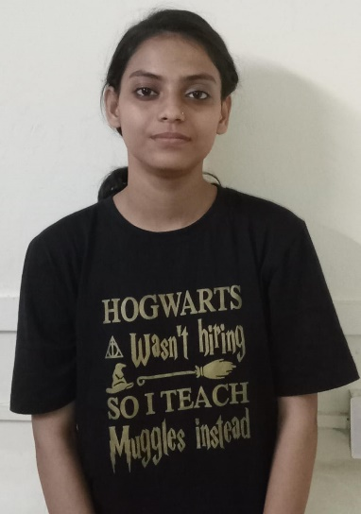
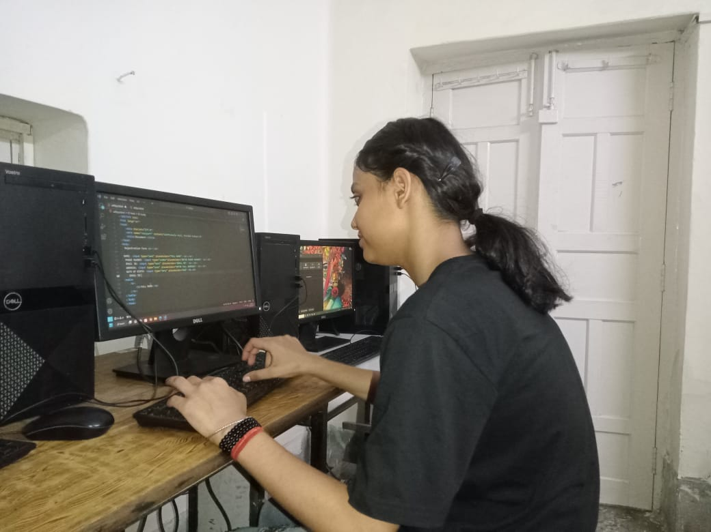
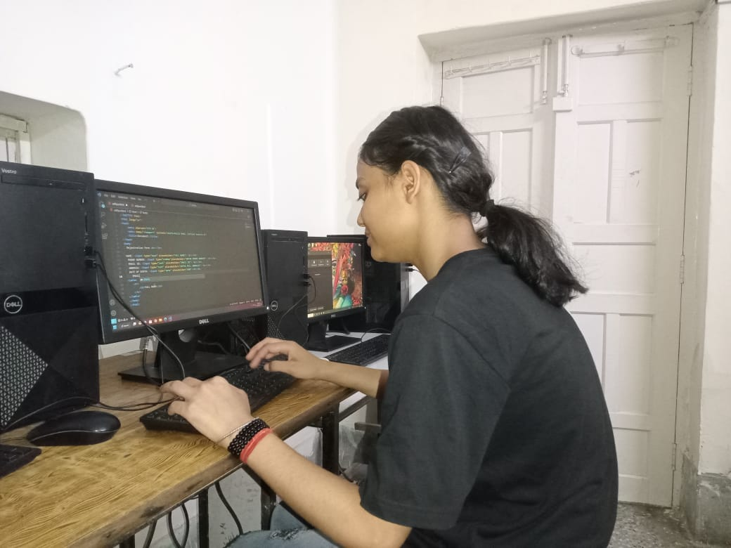
Achievements
In the bustling city of Gurugram, where aspirations often face towering challenges, the remarkable journey of Shalini Kumar stands as a shining to determination and ambition. At the age of 20, Shalini has defied the odds to become a successful salesgirl at More Hypermart in Sector 37, Gurugram, proving that with hard work and dedication, one can turn dreams into reality. Born into a family of six members, Shalini's father, Mr. Bablu Kumar, serves as a manager in a local company. His monthly income of 17,000 though modest, underscores the family's dedication and commitment to a better life. The Kumar family, with their humble beginnings in Basai Enclave, Gurugram, shared a common vision for a brighter future.Shalini's journey took a transformative turn when she set her sights on a career at More Hypermart in Sector 37, Gurugram. Armed with determination and a desire to make a difference, she decided to pursue a career as a salesgirl. Her relentless pursuit of this goal paid off when she was offered the position she had longed for. Shalini's role as a salesgirl at More Hypermart not only provides her with a steady monthly salary of 15,000 but also serves as a testament to her dedication and commitment to her career. Her journey is a living example of how dreams can be realized through unwavering determination.

Slide 15
Conclusion
The final conclusion is that we have given our 100%. What we have taught our students, we have given more knowledge to our students or we have got good response from the students, what instructions we have given to them, they have performed well.
Whatever session or training Literacy India has organized, we have attended all the sessions or whatever task they have been given, we have performed the task on time. And as many trainings as we have got like Curriculum training, robotics training, job readiness workshop and etc. We learn new technology and new techniques from a workshop or training.

Slide 16
Suggestion
Mentorship and Industry Engagement:
Establish mentorship programs with industry professionals to provide guidance and networking opportunities.

Slide 17
Thank You
Presented by-Abhilash Pathak

